Slide 1

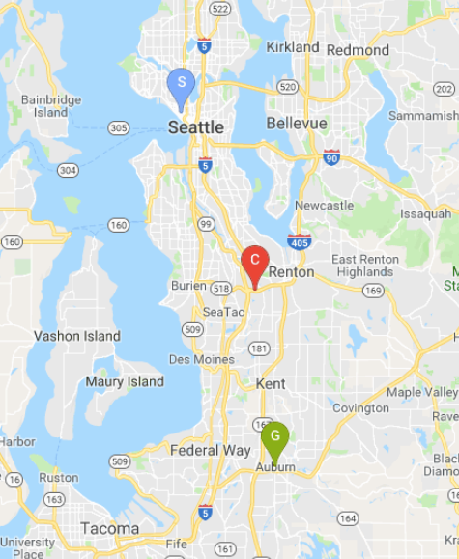

HALFWAYTHERE.US http://www.halfwaythere.us by CeRberus +1

Slide 2
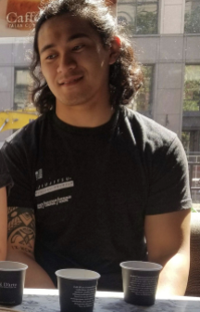
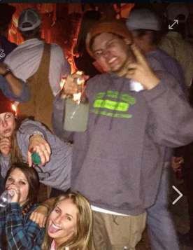
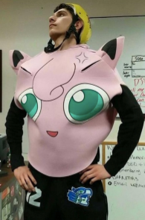
Team Introduction
Ray
Tanner
Pablo
Roger

Slide 3

Problem Domain
Given 2 user locations, find a meetup point halfway between the 2 users.
Given a venue type, find a location at the halfway point.

Slide 4

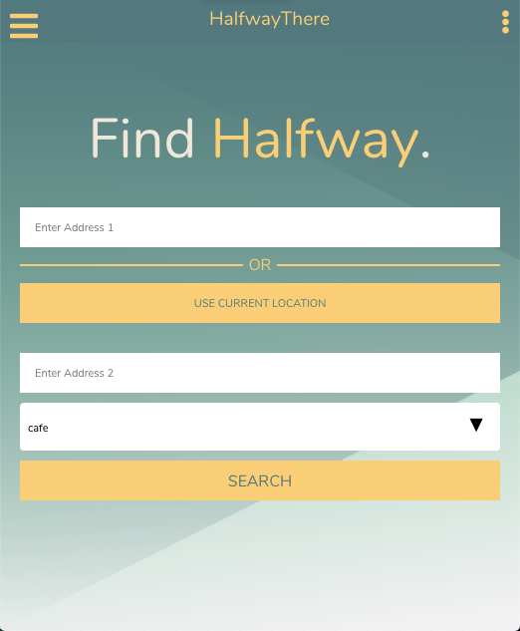



Application Demo

Slide 5
Contributions / Issues
Style Style Style
Database functionality
Content / Collaboration
Halfway calculations

Slide 6
Given Additional Time
User Login
Text / Notification to both users
Additional People to meetup
Administration Page
Data Analytics

Slide 7
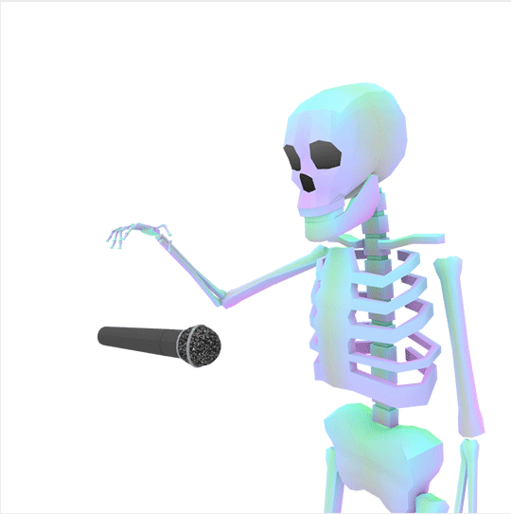
Questions / Comments

